Slide 1
MENINGITIS IN CHILDREN
ASHIONO E. M

Slide 2
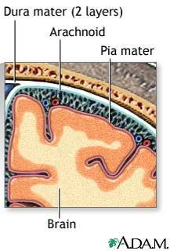
Definitions
Meningitis – inflammation of the meninges
Encephalitis – infection of the brain parenchyma
Meningoencephalitis – inflammation of brain + meninges
Aseptic meningitis – inflammation of meninges with sterile CSF
Notes:
Meningitis:
bacterial
viral
fungal
aseptic (Lyme, syphillis)
TB
Other causes of aseptic meningitis:
malignancy
NSAID’s
chemo
abx

Slide 3
KENYA
390 cases (1.3% of all admissions) of whom 88% were <5 years old
The apparent minimum annual incidence in children younger than 5 years of age increased from 120 to 202 per 100 000 between 1995 and 2000 (P < 0.001).
Increasing the lumbar punctures performed by including prostrated or convulsing children significantly increased the number of cases detected (P < 0.005).
The most common organisms in infants <3 months were streptococci and Enterobacteriaceae . Streptococcus pneumoniae (43.1%) and Haemophilus influenzae (41.9%) were predominant in the postneonatal period.

Slide 4
The overall mortality was 30.1%, and 23.5% of survivors developed neurologic sequelae.
Chloramphenicol resistance of H. influenzae rose from 8% in 1994 to 80% in 2000 (P < 0.0001) accompanied by an apparent increase in mortality.
A short history, impaired consciousness and hypoglycemia were associated with death.
Prolonged coma and low cerebrospinal fluid glucose were associated with neurologic sequelae.
Acute bacterial meningitis in children admitted to a rural Kenyan hospital: increasing antibiotic resistance and outcome MWANGI, ISAIAH MTROPPAEDS; BERKLEY, JAMES MRCP; LOWE, BRETT MPHIL; PESHU, NORBERT MPH; MARSH, KEVIN FRCP; NEWTON, CHARLES R. J. C. MD The Pediatric Infectious Disease Journal:
November 2002 - Volume 21 - Issue 11 - pp 1042-1048

Slide 5
KNH,NEONATES
The prevalence of meningitis amongst cases of suspected sepsis was 17.9%.
The male:female ratio was 1.5:1 mean birth weight 2116.7 grams (1682.2-2551.2) mean gestational age 35.7 weeks (32.6-38.8) and the mean postnatal age was 4.1 days (2.7-5.4) with none of the parameters being significantly different from those without meningitis.
Feed intolerance and lethargy were the most common clinical features, present in 73.3% and 60% of patients with meningitis respectively.
Neonates with meningitis had a higher mean CSF protein value (2.67 g/L vs 1.97 g/L, p=0.367) and a significantly higher mean CSF white cell count (21 cells/mL vs 7 cells/mL, p=0.001).
The most common aetiological agents were Escherichia coli (46.7%). Group B. Streptococci (26.7%) and Klebsiella pneumoniae (13.3%).

Slide 6
Most blood and CSF isolates were resistant to ampicillin and gentamicin but showed good in-vitro sensitivities to amikacin, cefuroxime and the third generation cephalosporins (ceftriaxone, ceftazidime and cefotaxime).
Blood cultures were positive in only 53.3% of neonates with meningitis.
Resistance to the commonly employed first-line antibiotics (penicillin and gentamicin) is high and a change of empirical antibiotic use for neonates with suspected sepsis is recommended.
Neonatal bacterial meningitis at the newborn unit of Kenyatta National Hospital. East Afr Med J. 2003 Sep;80(9):456-62
Laving AM, Musoke RN, Wasunna AO, Revathi G
Department of Paediatrics and Child Health, College of Health Sciences, University of Nairobi, PO Box 19676, Nairobi, Kenya

Slide 7
TRANSMISSION
Droplet transmission of bacteria from person to person
Close and prolonged contact e.g sneezing,coughing
Incubation period 2-10 days

Slide 8
Routes of infection
Nasopharynx
Bloodstream
Direct spread(skull fracture,meningo/encephalocele
Middle ear infection
Infected VP shunts
Congenital defects
Sinusitis

Slide 9
TYPES
Bacterial
Viral
Fungal
Parasitic
Non infectious

Slide 10
Bacterial meningitis - Organisms
Neonates
  Most caused by Group B Streptococci
  S.AureusE coli, enterococci, Klebsiella, Enterobacter, Samonella, Serratia, Listeria
Older infants and children
  Neisseria meningitidis, S. pneumoniae, tuberculosis, H. influenzae

Slide 11
NEONATES
0-7 days days - group B Streptococcus (GBS), E. coli, other enteric bacilli, and L. monocytogenes. Uncommon pathogens include other streptococci, non-typeable Haemophilus influenzae, Neisseria meningitidis, and Streptococcus pneumoniae.
7 days or older - antimicrobial-resistant gram-negative organisms must be considered in addition to above.
Hospitalized neonates seven days of age or older - gram-positive organisms must be considered in addition to antimicrobial resistant gram-negative organisms, GBS, E. coli, and L. monocytogenes.

Slide 12
HOST PATHOGEN INTERACTION
Variety of factors including preceding viral infections, inhalation of dry dusty air, or exposure to passive smoking have been associated with invasive disease
Meningococcus is able to adhere to non-ciliated epithelial cells through a number of adhesion factors, including pili

Slide 13
Bacterium avoids host immunological mechanisms in the nasopharynx by:
  production of IgA protease
  production of factors which inhibit ciliary activity
  possession of a polysaccharide capsule which promotes adherence and inhibits opsonophagocytosis
  variation in expression or structure of a variety of surface antigens, including proteins and endotoxin e.g In group B meningococci, the polysaccharide structure is nonimmunogenic, because of structural similarity with the human neural cell adhesion molecule (NCAM)

Slide 14
Host factors
Passive immunity
Acquired immunity
Complement pathway:Classical,alternate,MBL pathways- Individuals deficient in terminal components of the complement pathway or properdin,suffer recurrent infection.Individuals with mutations in the mannose binding lectin gene have an increased risk of meningococcal disease but appear less likely to suffer recurrent infections once antibodies have developed.

Slide 15
PATHOGENESIS OF BACTERIAL MENINGITIS
Entry of organism through BBB
Release of cell wall and membrane products
Outpouring of polymorphs and fibrin
Cytokines and chemokines
Inflammatory mediators
Inflammed meninges covered with exudate(most marked in pneumoccocal meningitis)

Slide 16
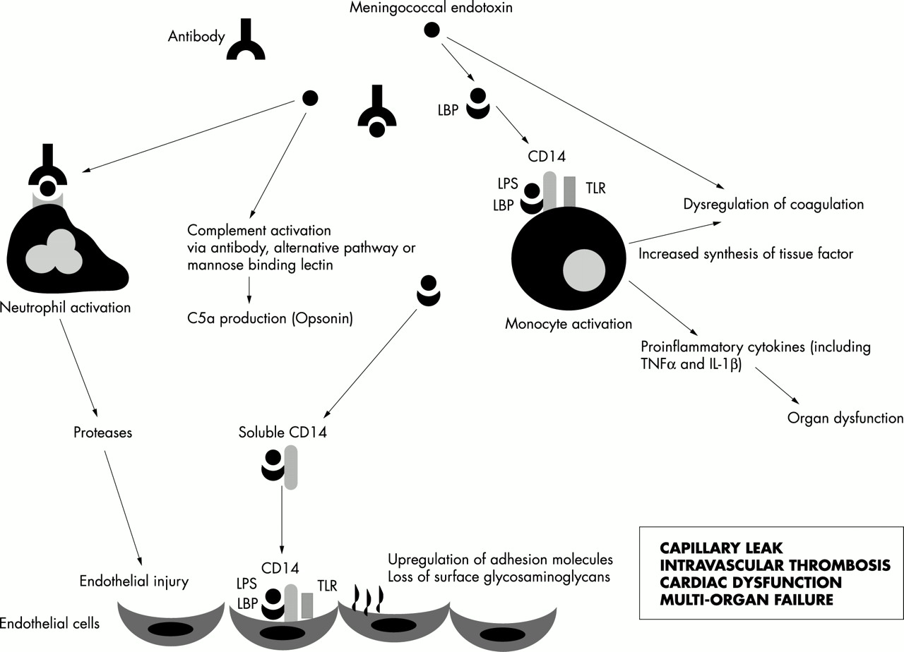
The inflammatory cascade in meningococcal septicaemia.
Pathan N et al. Arch Dis Child 2003;88:601-607
Notes:
The inflammatory cascade in meningococcal septicaemia.

Slide 17
MICROVASCULAR INJURY IN MENINGOCOCCAL SEPSIS
The complex physiology of meningococcal sepsis is largely explained by four basic processes affecting the microvasculature:
(1) Increased vascular permeability
(2) Pathological vasoconstriction and vasodilatation
(3) Loss of thromboresistance and intravascular coagulation
(4) Profound myocardial dysfunction.
These events are largely responsible for the development of shock and multiorgan failure.

Slide 18
Increased vascular permeability and the capillary leak syndrome
Hypovolemia, a direct result of a gross increase in vascular permeability, appears to be the most important early event leading to shock
Increased capillary leak due to:
  Increased inflammation
  Enzymatic degradation of endothelial surface proteins
  loss of the surface endothelial glycosaminoglycans
  Leads to loss of albumin,fluids and electolytes

Slide 19
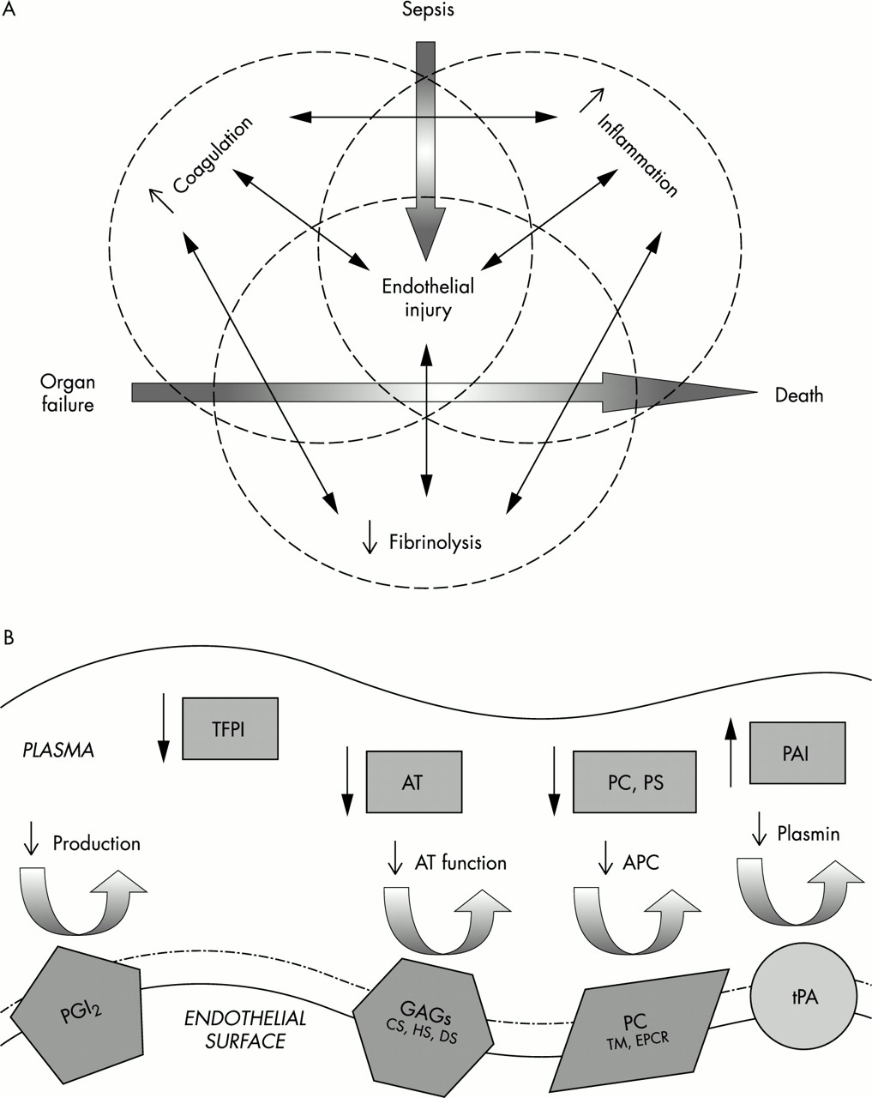
(A) The inflammatory, coagulation, and fibrinolytic pathways are linked at many levels, leading to organ failure and eventually death.
Pathan N et al. Arch Dis Child 2003;88:601-607
Notes:
(A) The inflammatory, coagulation, and fibrinolytic pathways are linked at many levels, leading to organ failure and eventually death. (B) The coagulation and fibrinolytic pathways rely on the function of endothelial proteins and protein complexes. Dysfunctional regulatory mechanisms in meningococcal disease include endothelial (protein C pathway) and plasma (TFPI, antithrombin, PAI) factors.

Slide 20
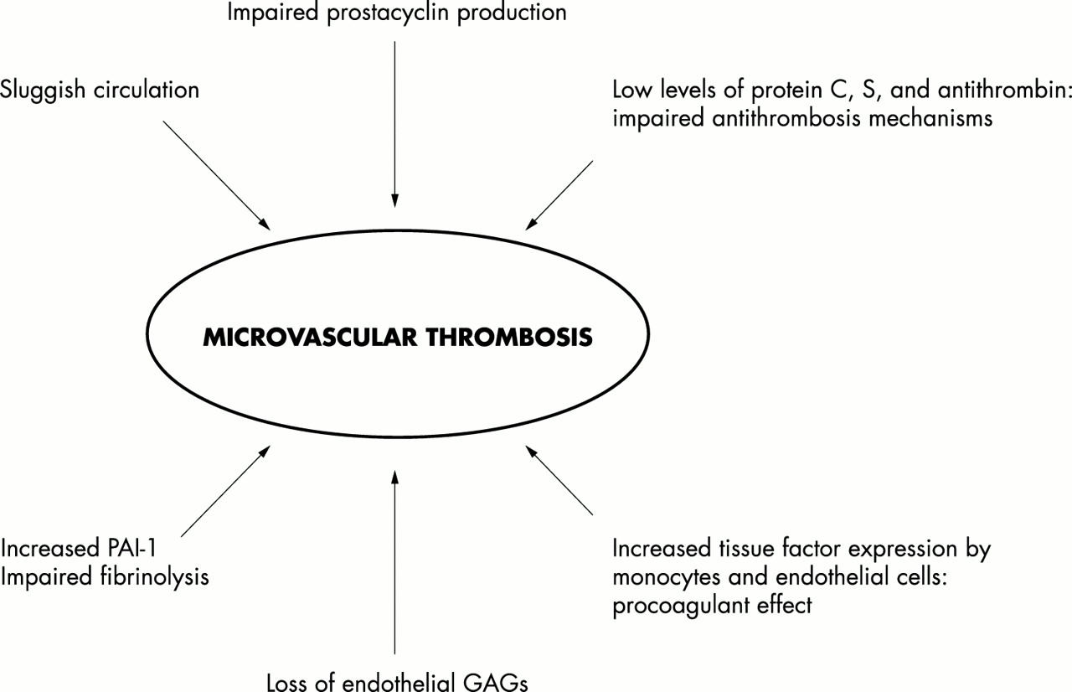
Factors involved in intravascular thrombosis and purpura fulminans.
Pathan N et al. Arch Dis Child 2003;88:601-607
Notes:
Factors involved in intravascular thrombosis and purpura fulminans.

Slide 21
NEUROLOGIC INJURY
Direct bacterial toxicity
Indirect inflammatory processes such as cytokine release, neutrophil activation, with resultant vasculitis, and cellular oedema
Cerebral oedema may be caused by increased secretion of CSF, diminished reabsorption of CSF, and breakdown of the blood-brain barrier

Slide 22
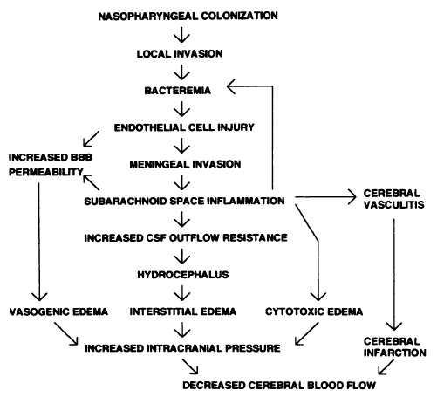
Pathogenesis and pathophysiology of bacterial meningitis

Slide 23
PATHOPHYSIOLOGY
Meningeal irritation signs:Inflammation of the spinal nerves and roots
Hydrocephalus:Adhesive thickening of the arachinoid in basal cistern or fibrosis of aqueduct or foramina of Luschka or Magendie
Cerebral atrophy: Thrombosis of small cortical veins resulting in necrosis of the cerebral cortex

Slide 24
Seizures: Depolarization of neuronal membranes as a result of cellular electrolyte imbalance
Hypoglycorhachia: Decreased transport of glucose across the inflammed choroid plexus and increased usage by host

Slide 25
Symptoms and Signs of Bacterial Meningitis
Rapid Onset (25%) hospitalized < 24h
Respiratory Symptoms days – weeks
Headache 90% Meningismus 85%
Fever >90% Focal neurosigns 25%
consciousness 80% Ocular palsies – 10%
Vomiting – 30% Hemiparesis
Seizures – 30% Myalgias 20%
Petechiae/purpura 50% (meningo.)
Papilledema 1%
Δ

Slide 26
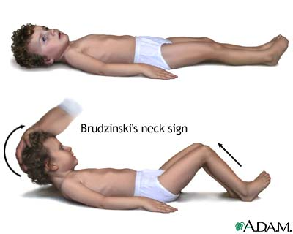
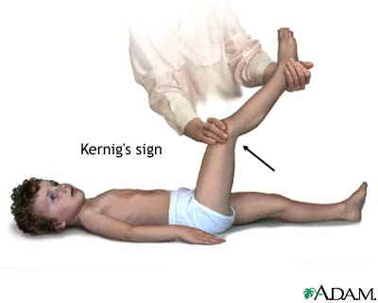
Clinical signs of meningeal irritation
Notes:
Brudzinski – pt lies supine, head is passively elevated by examiner, involuntary flexion of knees
Kernig – pt lies supine with knees flexed, knees extended, complain of pain in back or neck

Slide 27
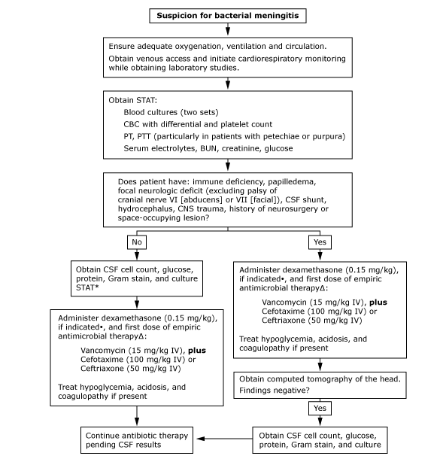
Management algorithm for infants (>1 month) and children with suspected bacterial meningitis

Slide 28
VIRAL MENINGITIS
Comprises most aseptic meningitic syndromes.
Agents include:
  Enterovirus(Polio,Echovirus,Coxsackievirus
  Herpesvirus(HSV,EBV,Varicella Z)
  Paramyxovirus(Mumps,Measles)
  Togavirus(Rubella)
  Rhabdovirus9Rabies)
  Retrovirus(HIV)

Slide 29
FUNGAL MENINGITIS
Rare in healthy children
Higher risk in those with HIV/AIDS,immunodeficiency/immunosuppression syndromes
Most common agents are Cryptococcus neoformans,Candida,H capsulatum

Slide 30
PARASITIC MENINGITIS
Infection with free living amoeba is an infrequent but often life threatening human illness
More common in developing countries,usually caused by parasite found in contaminated water,food and soil
Most common causative agents are: free living amoeba(Acanthamoeba,Balamuthia,Naegleria)Helminthic eosinophilic meningitis

Slide 31
NON-INFECTIOUS MENINGITIS
SLE
Rare causes include exposure to certain meds such as
  Immune globulin
  Levamisole
  Metronidazole
  MMR
  NSAIDS

Slide 32
TBM
Complication of childhood TB and common cause of prolonged morbidity,handicap and death
Children below 5yrs of age at risk

Slide 33
C/F
Always secondary to primary TB
First Phase: prodromal phase, lasting two to three weeks
Vague symptoms
  Child dull,irritable,restless,or drowsy
  Anorexia & vomiting may be present
  Older child may c/o headache
  Often preceding history of illness with incomplete recovery
  low-grade fever
  personality change.

Slide 34
Second phase: meningitic phase
Confusion,drowsy,neck stiffness and rigidity, and protracted headache
Vomiting,lethargy
Kerning and Brudzinski sign may be positive,bulging of ant fontanelle
Twitching of muscles,convulsions,fever
Strabismus,nystagmus and papilloedema may be present
Fundoscopy: Choroidal TB may be seen
Varying degrees of cranial nerve and long-tract signs

Slide 35
Terminal phase: paralytic phase
Confusion gives way to stupor and coma,opisthotonus position
Multiple focal paresis
CN palsies present
High grade fever persists
For the majority of untreated patients, death ensues within five to eight weeks of the onset of illness

Slide 36
CLINICAL STAGES
Useful for prognosis and therapy
Stage I patients are lucid with no focal neurologic signs or evidence of hydrocephalus.
Stage II patients exhibit lethargy, confusion; may have mild focal signs, such as cranial nerve palsy or hemiparesis.
Stage III represents advanced illness with delirium, stupor, coma, seizures, multiple cranial nerve palsies, and/or dense hemiplegia.

Slide 37
Diagnostic accuracy of physical findings in adults with suspected meningitis*
297 patients, 80 (27%) with “meningitis”
18/80 microbiologic dx; 3 bacterial
Kernig’s, Brudzinskis signs: sens = 5%, NPV = 72%
Nuchal rigidity sens = 30% NPV = 73%
CSF wbc >1000 sens = 100% NPV = 100%
*Thomas KE, et al. Clin Infect Dis 2002; 35:46-52.

Slide 38
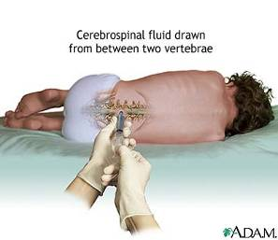
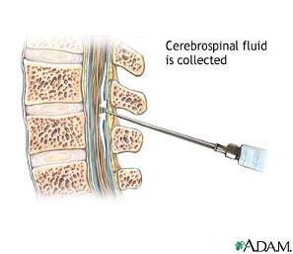
Diagnosis – lumbar puncture
Contraindications:
  Respiratory distress (positioning)
  ↑ ICP reported to increase risk of herniation
  Cellulitis at area of tap
  Bleeding disorder
Notes:
Needle with stylet inserted into the subarachnoid space between L3-4 or L4-5.
Styleted needled used so as to not introduce a plug of epidermal cells into the space which may later grow into a cord-compressing epidermoid tumor.
Contraindications:
monitor sats
signs of inc ICP – ptosis, anisocoria, 6th nerve palsy, Cushing’s triad (HTN, brady, irreg resp) or pappilledema
GIVE abx anyway

Slide 39
CSF evaluation
Condition | WBC | Protein (mg/dL) | Glucose (mg/dL)
Normal | <7, lymphs mainly | 5-45 | >50
Bacterial, acute | 100 – 60K PMN’s | 100-500 | Low
Bacterial, part rx’d | 1 – 10,000 | 100+ | Low to normal
TB | 10 – 500 | 100-500 | <50
Fungal | 25 – 500 | 25-500 | <50
Viral | <1000 | 50-100 | Normal
Notes:
RBC – traumatic vs CNS bleeding. After a few hours, CSF will be xanthrochromic; if traumatic it will be clear with centrifugation.
Latex agglutination has high false negative rate.

Slide 40
Who has bacterial meningitis and who needs an LP? – consider 100 cases of meningitis
Clinical signs in a febrile child |  | Able to detect | Missed | Number over-diagnosed
1 | Bulging fontanelle / Stiff neck | 40 | 60 | 110
2 | Signs in 1 or fits aged <6m or fits aged > 6yrs | 60 | 40 | 215
3 | Signs in 1 or 2 or partial or focal convulsions | 70 | 30 | 495
4 | Signs in 1 or 2 or 3 or reduced consciousness | 80 | 20 | 915
Notes:
So what happens in real life? (See Berkley, 2004)
If we imagine 100 cases of meningitis research has shown that only 40/100 are detected by the signs of a bulging fontanelle or a stiff neck – so 60/100 would be missed if we only do LPs on this group. Even with only these two signs there are nearly 3 times as many children who turn out not to have meningitis when they have an LP as there are real cases of meningitis 110 vs 40.
If we add to the signs bulging fontanelle and stiff neck another sign, a history of fits if the child is aged<6 months or older than 6yrs (ie outside the febrile convulsion age range) then we capture more of the meningitis cases, now 60/100. We still miss 40/100 and the price we pay for widening the net is that now almost 4 times as many children we identify and do an LP on will not have meningitis (60 vs 215).
As we add signs – move down the table – we reach a stage when we can detect 80/100 cases of meningitis, the price we pay however is that only 1 in 10 LPs are likely to be positive.

Slide 41
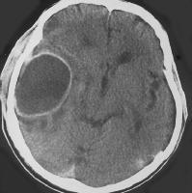
So what is a sensible rule for LP?
At a minimum, if you want to avoid missing meningitis (and deaths and handicap from it), and avoid wasting antibiotics, at least LP those with history of fever and one of:
  Bulging fontanelle
  Stiff neck
  Fits if age <6 months or > 6 yrs
  Partial or focal fits
  Reduced consciousness
Notes:
1) If we want to avoid missing meningitis and the deaths and disability that it causes (the CT scan is a cerebral abscess in a child who did not have their meningitis recognised or treated properly) then should do an LP in children with ANY ONE of the signs listed on the slide.

Slide 42
Value of LP findings – Acute bacterial meningitis.
All the true acute bacterial meningitis cases
Notes:
1) Consider the red pyramid to represent all of the cases of acute bacterial meningitis.

Slide 43
Bedside assessment alone is very helpful.
75% of acute bacterial meningitis cases can be detected by examining for CSF cloudiness or turbidity at the bedside.
Notes:
1) Even if all that is done on the CSF is to look at it in the bottle for turbidity this can detect about 75% of cases of true meningitis – confirming the diagnosis in these real cases (see Berkley, 2004)

Slide 44
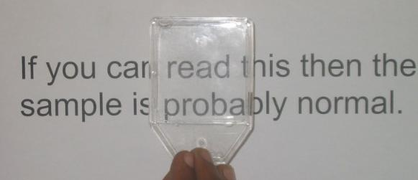
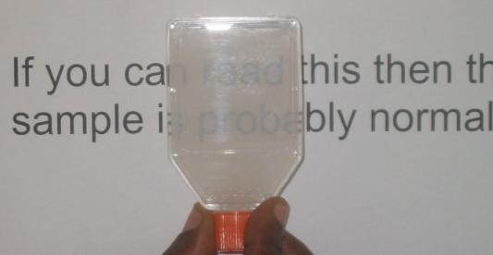
CSF Cloudiness / Turbidity
A simple test of CSF turbidity is to see if normal print can be read easily through the sample – CSF should be crystal clear.
Cloudiness usually appears at CSF WBC counts > 200x10⁶ Wbc per L
Notes:
This is obviously a mock up but a simple test for cloudiness is to see if normal text can be read through the bottle perfectly – if not then the CSF is cloudy.

Slide 45
CSF culture is great but if it is not available a microscope will provide nearly all you need to know.
82% of acute bacterial meningitis cases can be detected by either turbidity or a CSF white cell count and using a cut-off of >50 Wbc per μL. (>50 x 10⁶ Wbc per L)
Notes:
Even if the laboratory cannot do any culture 82% of cases can be identified and confirmed by visual inspection and cell count alone – a cutoff of 50 x 10⁶ Wbc per L is recommended (see Berkley, 2004)

Slide 46
CSF microscopy, blood and CSF glucose measures are highly sensitive.
96% of acute bacterial meningitis cases can be detected by turbidity, a CSF white cell count of >50 Wbc per μL (>50 x 10⁶ Wbc per L) or a CSF glucose to Blood glucose ratio <0.1*
* Books suggest a ratio of ~0.6, this is much too high to be useful
Notes:
Adding a blood glucose to CSF glucose ratio to the visual inspection and cell count increases the proportion of true cases that can be positively identified to 92% - without any culture available.
It should be noted that the ratio of CSF to Blood glucose quoted in many textbooks is too high and a ratio of 0.1 is more useful.

Slide 47
MICROSCOPY – GRAM STAIN
Absence of organisms on Gram stain does not exclude the diagnosis .
The probability of visualizing bacteria depends upon the number of organisms present and is increased by cytocentrifugation
An organism is visualized on CSF Gram stain in approximately 90 percent of children with pneumococcal meningitis and 80 percent of children with meningococcal meningitis.
In contrast, Gram stain is positive in only one-half of patients with gram-negative bacillary meningitis and one-third of patients with listeria meningitis

Slide 48
MICROSCOPY
Gram-positive diplococci suggest S. pneumoniae
Gram-negative diplococci suggest N. meningitidis)
Small pleomorphic Gram-negative coccobacilli suggest Hib
Gram-positive cocci or coccobacilli suggest group B streptococcus
Gram-positive rods and coccobacilli suggest L. monocytogenes

Slide 49
LP changes after antibiotics.
Prior antibiotic use reduces the sensitivity of CSF gram stain by 20% and CSF culture by 30%.
It takes 24-36 hours of therapy before >90% of CSF cultures will be sterile.
It takes 2-3 days of therapy to change the WBC cell count of CSF in true bacterial meningitis.
Prior treatment is no excuse for not doing an LP!
Notes:
In fact several studies (see Curtis, 2005) demonstrate that successful culture is quite possible after antibiotics have been given.
More importantly (since culture is not possible in many places) it takes at least 2-3 days for the WBC count to fall after the onset of therapy see (meningitis summary).
There really is no excuse for not doing an LP.

Slide 50
LATEX AGGLUTINATION
Commercial kits utilizing latex beads coated with antibodies to meningococcal capsular antigens are available for use in body fluids other than blood (eg, CSF and urine)
Detect agglutination of five capsular types: A, B, C, Y, and W135.
The sensitivity for serogroup B is low, and false negative results can occur

Slide 51
POLYMERASE CHAIN REACTION
Detects small quantities of bacterial DNA
Has the potential to be an important tool in the rapid diagnosis of meningococcal infection.
Advantages compared to culture for the diagnosis of meningococcal infection include:
  It can establish the diagnosis more rapidly
  Since viable bacteria are not required, sensitivity is not affected by prior antibiotic administration
  It can rapidly type strains, a useful adjunct in situations that appear to be an epidemic in evolution
  Multiplex PCR permits simultaneous testing for meningococcal, pneumococcal, and Haemophilus influenzae infection

Slide 52
PCR Cont:
Also useful in diagnosis of TBM and viral meningitis
Methods for the rapid detection of M. tuberculosis in CSF include the nucleic acid-based amplification test (NAAT) that relies upon PCR
Poor sensitivity,largely attributed to the difference in sample volume between PCR (typically around 50 microL) and culture (several mL)

Slide 53
OTHER TESTS
Serum C-reactive protein - not a reliable indicator of severe infection
In retrospective cohorts, elevated serum procalcitonin (>0.5 ng/mL) appears to be helpful in distinguishing bacterial from viral meningitis
Presence of tumor necrosis factor may distinguish bacterial from viral meningitis
Presence of IL-1 or IL-10 also may correlate with meningitis, but whether these indicators are sensitive and specific enough to accelerate the diagnosis remains to be determined

Slide 54
But the lab needs….
Specimens before treatment ideally
CSF must be processed within 1 hour of collection
  CSF cannot be put in a fridge
  Only put CSF in an incubator if the temperature is < 15⁰C and it cannot be taken to the lab quickly.
Notes:
But a lab is only as good as the specimens it receives.
CSF is hypotonic so Wbc’s will lyse (break down) if left standing in CSF for too long. So CSF must be analysed rapidly, within 1 hour it should be under a microscope.
CSF cannot be put in a fridge – this kills any organisms.
If it has to be left somewhere it should be left at room temperature unless the temperature goes below 15⁰C then the CSF is better off in an incubator.

Slide 55
TREATMENT
Empiric regimen for infants and children older than 1 month with bacterial meningitis include coverage for antibiotic-resistant S. pneumoniae, N. meningitidis, and Hib
Cefotaxime (300 mg/kg/d[IV], maximum dose 12 g/day, in 3 or 4 divided doses) or
Ceftriaxone (100 mg/kg/d IV, maximum dose 4 g/day in 1 or 2 divided doses) plus
Vancomycin (60 mg/kg per day IV, maximum dose 2 g/day, in 4 divided doses)

Slide 56
DURATION OF THERAPY
S. pneumoniae — 10 to 14 days
N. meningitidis — 5 to 7 days
Hib — 7 to 10 days
L. monocytogenes — 14 to 21 days
Gram-negative bacilli — 3 weeks or a minimum of 2 weeks beyond the first sterile culture, whichever is longer

Slide 57
Pneumococcal resistance
Strep pneumococcus - most common cause of invasive bacterial infections in children >2 months old
Incidence of PCN-, cefotaxime- & ceftriaxone-nonsusceptible isolates has ↑’d to ~40%
Strains resistant to PCN, cephalosporins, and other β-lactam antibiotics often resistant to trimethoprim-sulfamethoxazole (Bactrim™, Septra™), erythromycin, chloramphenicol, tetracycline
Notes:
Resistant organisms do NOT cause more sggressive disease

Slide 58
Mechanism of resistance
PCN-binding proteins synthesize peptidoglycan for new cell wall formation
PCN, cephalosporins, and other β-lactam antibiotics kill S pneumoniae by binding irreversibly to PCN-binding proteins located in the bacterial cell wall
Chromosomal changes can cause the binding affinity for the β-lactam antibiotics to decrease

Slide 59
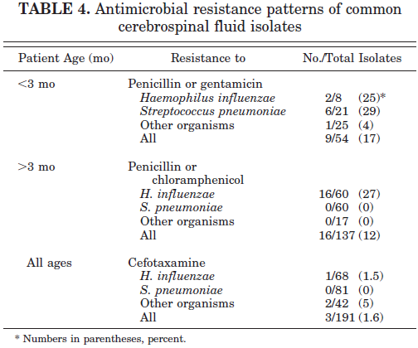
Kilifi study

Slide 60
Other antibiotics in pneumococcal meningitis (resistant)
Meropenem
  Carbapenem
  120 mg/kg/day ÷ Q 8 h
  ↑ seizure incidence, ∴ not generally used in meningitis
  Resistance reported
Rifampin
  20 mg/kg/day ÷ Q 12
  Not a solo agent
  Slowly bactericidal

Slide 61
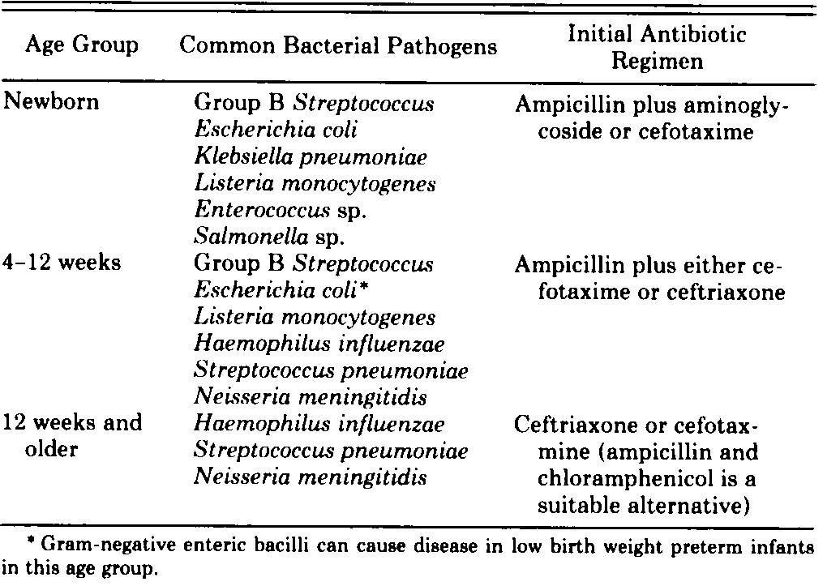

Slide 62
Dexamethasone use in meningitis
Consider if H flu & S pneumo meningitis & > 6 wks old 0.6 mg/kg/day ÷ Q 6h x 2d
↓ local synthesis of TNF-α, IL-1, PAF & prostaglandins resulting in ↓ BBB permeability, ↓ meningeal irritation
Debate if it ↓ incidence of hearing loss
If used, needs to be given shortly before or at the time of antibiotic administration – within 1hr
May adversely affect the penetration of antibiotics into CSF
Notes:
Conflicting results of small studies
May decrease fever, giving false impression of improvement

Slide 63
Meningococcemia - Treatment
Antibitotic resistance rare
Antibitotics:
  PCN
  Cefotaxime or Ceftriaxone
Patient should get rifampin prior to discharge

Slide 64
Meningococcemia - Prophylaxis
No randomized controlled trials of effectiveness
Treat within 24 hours of exposure
Vaccinate affected population, if outbreak

Slide 65
Meningococcemia - Prophylaxis
Rifampin
  Urine, tears, soft contact lenses orange; OCP’s ineffective
  <1 mo 5 mg/kg PO Q 12 x 2 days
  >1 mo 10 mg/kg (max 600 mg) PO Q 12 x 2 days
Ceftriaxone
  ≤12 y 125 mg IM x 1 dose
  >12 y 250 mg IM x 1 dose
Ciprofloxacin
  ≥18 y 500 mg PO x 1 dose

Slide 66
Meningococcal meningitis - Outcomes
Substantial morbidity: 11% - 9% of survivors have sequelae
  Neurologic disability
  Limb loss
  Hearing loss
10% case-fatality ratio for meningococcal sepsis
1% mortality if meningitis alone

Slide 67
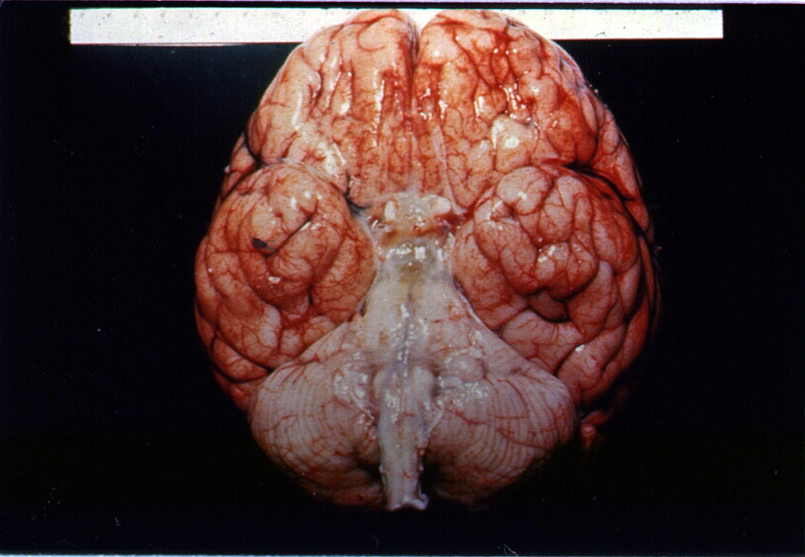
TB meningitis
CSF:
  Profoundly low glucose
  High protein
  Acid-fast bacteria (AFB stain)
  PCR
Steroids + anti TBs

Slide 68
Viral meningitis - Treatment
Supportive
No antibiotics
Analgesia
Fever control
Often feel better after LP
No isolation - Standard precautions
Notes:
Not clear why sometimes feel better after diagnostic LP

Slide 69
Viral meningitis - Outcomes
Adverse outcomes rare
Infants <1 year have higher incidence of speech & language delay

Slide 70
Herpes simplex 1 encephalitis
Symptoms
  Depressed level of consciousness
  Blood tinged CSF
  Temporal lobe focus on CT scan or EEG
  + PCR
  Neonates typically will have cutaneous vessicles
Treatment - IV acyclovir, <12 years, 60 mg/kg/d, ≥ 12 years old, 30 mg/kg/d TID for 14-21 days
Notes:
Polymerase chain reaction to herpes DNA

Slide 71
Vaccines
Streptococcus pneumoniae - conjugate vaccines and Pneumococcal polysaccharide vaccines in children
Neisseria meningitidis - Meningococcal vaccines - Immunizations for children age 7 to 18 years
Haemophilus influenzae type b (Hib) – Penta valent vaccine

Slide 72
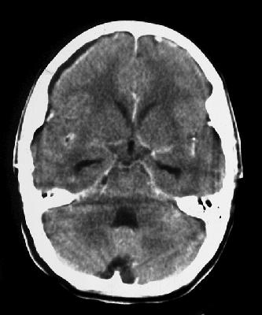
Meningitis - Acute complications
Hydrocephalus
Subdural effusion or empyema ~30%
Stroke
Abscess
Dural sinus thrombophlebitis
Notes:
Recurrent fever may be associated with subdural effusion, abscess, drug fever.
May warrant repeat LP.
Effusions may or may not need intervention – depends on if it is increasing or causing neurologic sxs.

Slide 73
REFERENCES
Nelson’s textbook of pediatrics 21st edition
Up to date

Slide 74
THANK YOU!

